Slide 1
California stay-at-home order
Initially enforced on March 19^{th.}
Questions:
Was this order effective?
Is it too soon to re-open California? How about other states?
Dataset info: Time series dataset updated daily with the total confirmed & death cases of COVID-19 in U.S (categorized by states).
Source: CSSE at John Hopkins University.

Slide 2
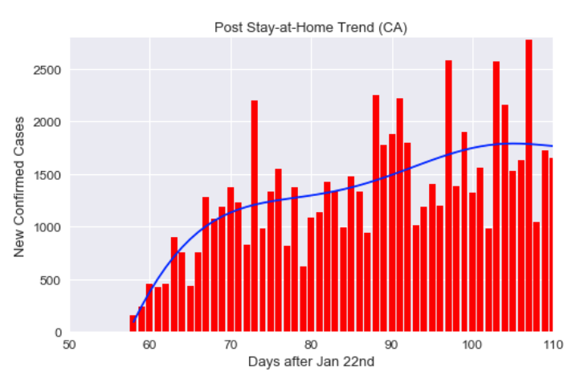
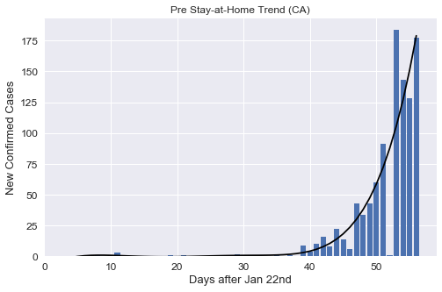
Pre vs. post stay-at-home order
Was the Stay-at-Home Order effective?
Yes, by enforcing this rule, we were able to limit the growth and “flatten” the curve. (Remember: the purpose of the order was to prevent the possibility of overloading hospitals, not to cure or eliminate COVID-19).
Notes:
Consider talking about:
Language of disease

Slide 3
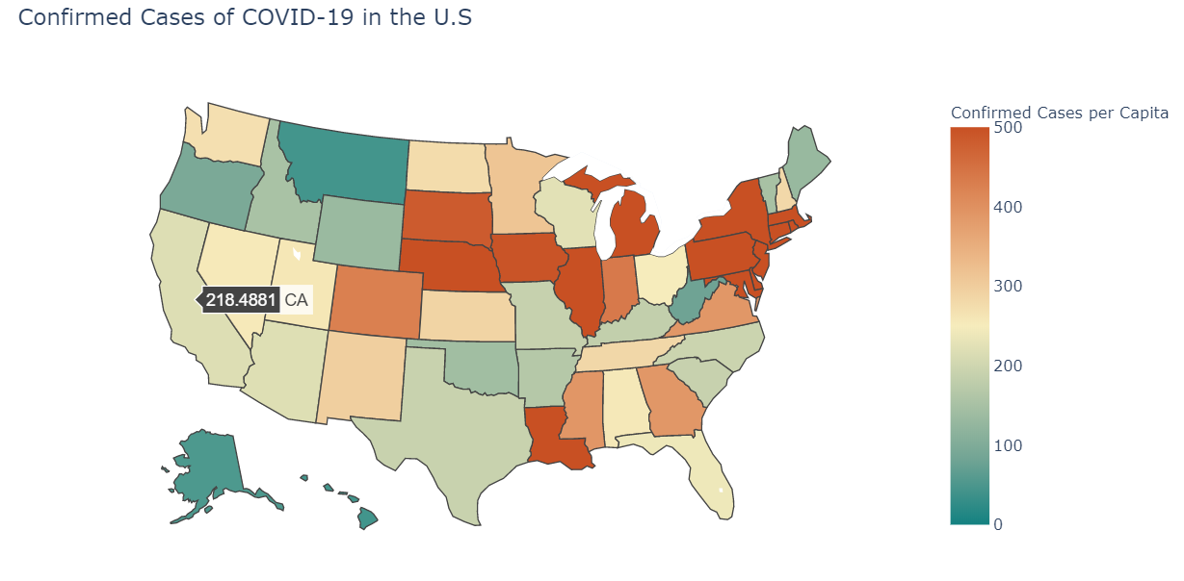
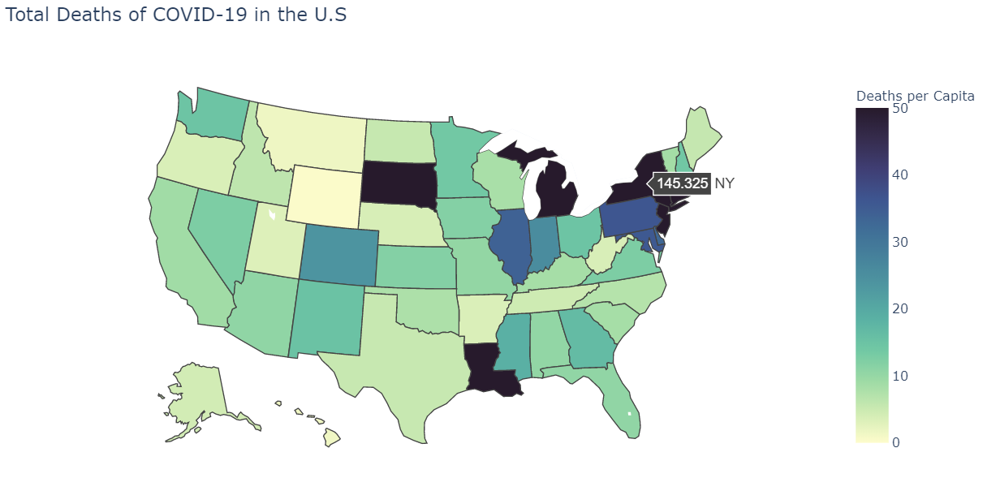
Current state of covid-19 in u.s
Is it too soon to re-open California? Or other states?
For California, possibly. The current condition of COVID-19 varies from state to state, it’s hard to say.
Notes:
Consider talking about:
Language of disease

